Slide 1
Lean & Kanban
Software Engineering, ITI, SD #43
Supervised By: Eng. Basma Hussein
Presented By:
Ahmed Negmeldin
Ahmed Taha
Sherif Hisham
Mahmoud Hossam

Slide 2
Lean
Introduction and History

Slide 3
What is Lean ?
is a way of thinking about creating needed value with fewer resources and less waste. And lean is a practice consisting of continuous experimentation to achieve perfect value with zero waste. Lean thinking and practice occur together.

Slide 4
History of Lean
The term “Lean” has its origins in manufacturing where it was coined to describe a manufacturing model based on the Toyota Production System (TPS) originally developed by Sakichi Toyoda, Kiichiro Toyoda, and Taiichi Ohno who were originally inspired by Henry Ford. TPS was focused on the philosophy of “the complete elimination of all waste”

Slide 5
History of Lean
cont’d
it was in 2003 that Mary Poppendieck and Tom Poppendieck first introduced the application of Lean principles to software development
Mary Poppendieck:
“We learnt that by focusing on value , flow and people , you got better Quality , Lower Cost and Faster Delivery”

Slide 6
Lean : Values and Principles

Slide 7
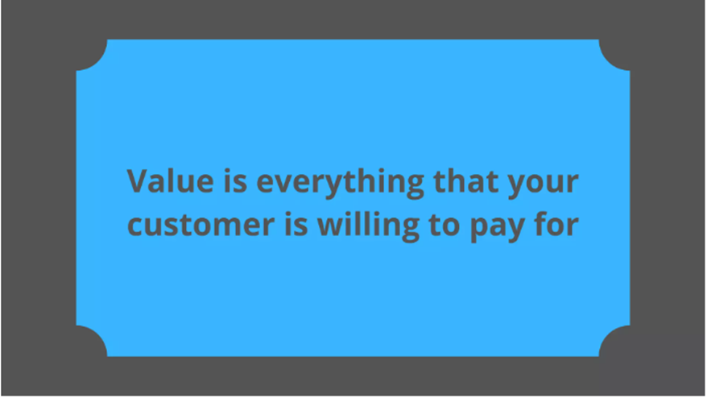
what is the Main Value of Lean ?
the value should always be considered from a customer perspective. At the end of the day, it doesn’t matter whether you came up with a great idea if the customer doesn’t see any value, and therefore she is not ready to pay for it

Slide 8
7 Principles of Lean Software Development
Eliminate Waste
Amplify Learning
Decide As late As Possible
Deliver as Fast as Possible
Empower The Team
Build Quality in
Optimize the Whole

Slide 9
Principles of Lean Software Development
cont’d
1- Eliminate Waste
The 7 Types of Waste in Different Environments
1 - partially done work : not completed .
2- extra features : producing features that nobody is going to use
3- Motion : unnecessary meetings or extra effort to find information

Slide 10
Principles of Lean Software Development
cont’d
1- Eliminate Waste
The 7 Types of Waste in Different Environments
4- Waiting : waiting for testing to complete, waiting for code review, and so on
5 - Task switching : switching between tasks too often, countless interruptions from colleagues.
6 - Over-processing : unnecessary complex algorithms solving simple problems
7 - Defects : bugs

Slide 11
Principles of Lean Software Development
cont’d
2- Amplify Learning
Pair programming and peer code review
Knowledge-sharing sessions and training events
Running tests immediately after the code is written
Gathering customer feedback

Slide 12
Principles of Lean Software Development
cont’d
3- Decide As late As Possible
This principle minimizes uncertainty before any critical development decisions
Planning broadly, without too much detail
Always leaving room for change
Experimenting to gather as much information as possible
Putting off irreversible decisions till the last moment

Slide 13
Principles of Lean Software Development
cont’d
4- Deliver as Fast as Possible
• Developing a product iteratively (usually in 2-4 week sprints)
• Using up-to-date prioritization methods like the MoSCow technique to prioritize features
https://www.productplan.com/glossary/moscow-prioritization (MoSCow technique )

Slide 14
Principles of Lean Software Development
cont’d
5- Empower The Team
The concept of lean software development is all about respect.
Allowing team members to share ideas safely
Ensuring that all team members have the same product vision
Entrusting employees with making independent decisions about their tasks
Recognizing performance and professional achievements
Encouraging people to speak up at work

Slide 15
Principles of Lean Software Development
cont’d
6 - Build Quality in
The principle of building quality in says that software issues should be solved immediately, not later on
Checking product quality after each step
Introducing pair programming to identify errors early on
Practicing test-driven development
Automating testing to streamline the process

Slide 16
Principles of Lean Software Development
cont’d
7 - Optimize the Whole
Ensuring that all team members have a good understanding of the product they’re building, the strategy behind it, and the related development process
Optimizing the entire value stream, not separate system functions
Ensuring effective and borderless communication within the team
By following this principle, you will also bond your team and strengthen its commitment to the project.

Slide 17
Lean Tools

Slide 18

Lean Agile Tools
Seeing Waste
Value Stream Mapping
Pull System
Cost Of Delay
Queuing Theory
Option Thinking

Slide 19
Lean Agile Tools
Cont’d
Perceived & Conceptual Integrity
Set Based Development
Focusing On Delivering MMFS and MVPS

Slide 20

Seeing Waste Tool
This tool detects wastes that everything that don’t add value to the final product and remove them from the process
This tool implement the Eliminate Waste Principle

Slide 21

Value Stream Mapping Tool
it allows leaders and stakeholders to see where the flow of value delivery is slowing down
exposes opportunities to create better alignment across teams.
it’s one of those practices commonly exercised after everyone is acutely aware that flow is slow or stagnant

Slide 22
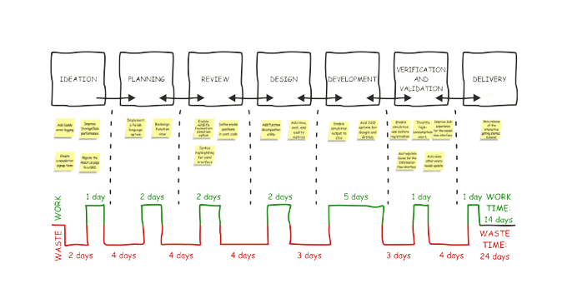
Value Stream Mapping Tool

Slide 23
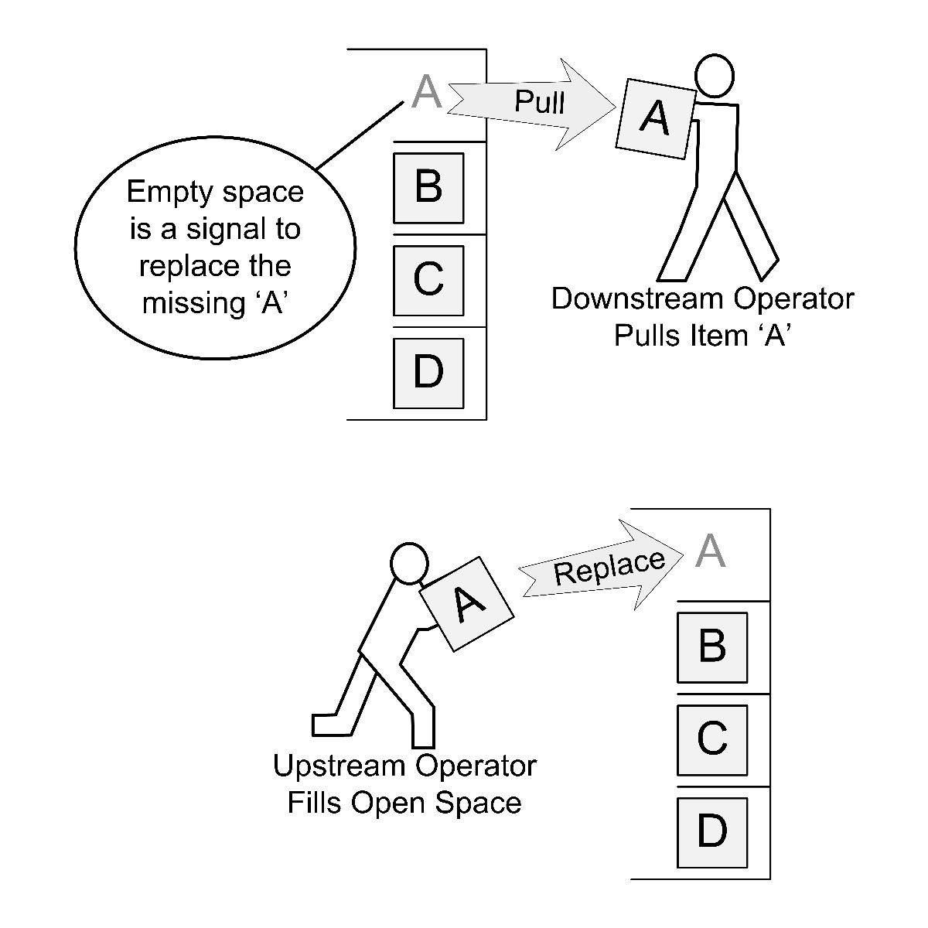
Pull System Tool
A pull system is a Lean technique for reducing the waste of any process
pull system allows you to start new work only when there is customer demand for it.
This allows you to reduce overhead and optimize storage costs.

Slide 24
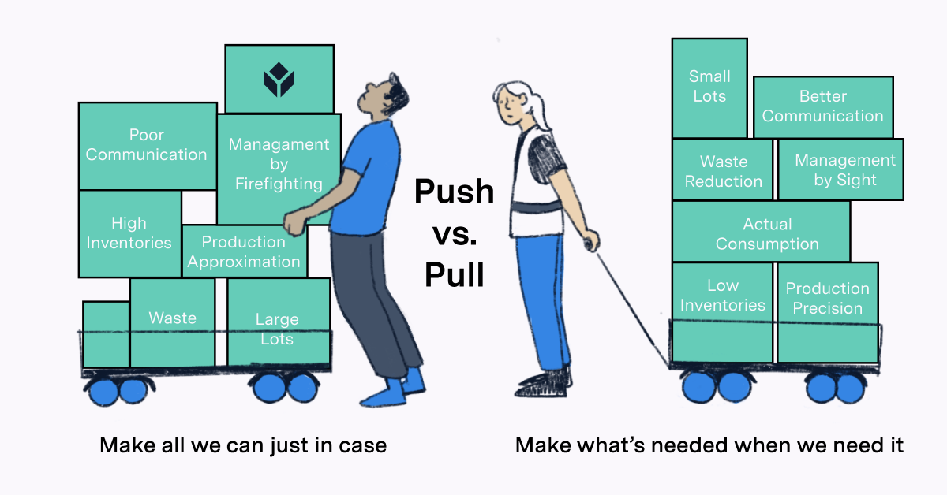
Pull System Tool

Slide 25

Cost Of Delay Tool
Cost of delay (CoD) is a key metric in lean management that represents the economic impact of a delay in project delivery.
the amount of money you will lose if you delay the release of a groundbreaking feature that will give you an advantage over the competition.

Slide 26

Queuing Theory Tool
Queueing theory describes the statistical and theoretical behavior of queues.
In a queue system, there are two basic parts: work items and worker units. Worker units perform some work upon work items.

Slide 27
Queuing Theory Tool
Cont’d
The streaming of work items through worker units composes a queueing system.
The time it takes for a work item to enter the system to exit the system is the process cycle time.

Slide 28
Kanban model

Slide 29
What is Kanban
Kanban combines some of the Lean, and Agile values and principles
Kanban is a visual system for managing work as it moves through a process
Goals of Kanban:
Identify potential bottlenecks in the process
Cost-effectiveness at an optimal speed or throughput
A process to gradually improve any workflow:
software development, IT/ Ops, Staffing, Recruitment, Marketing and Sales, Procurement etc.

Slide 30
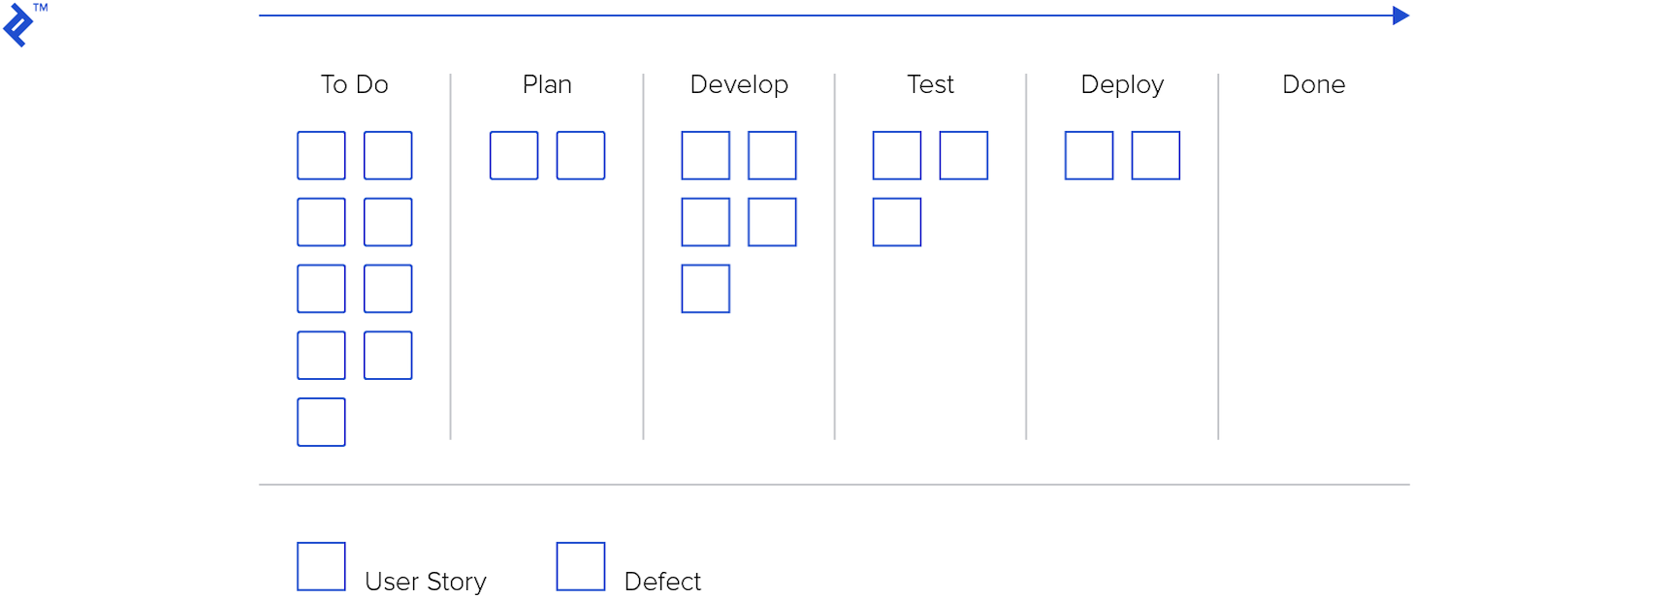
What is Kanban
cont’d
Fixed Date, High priority, …..

Slide 31
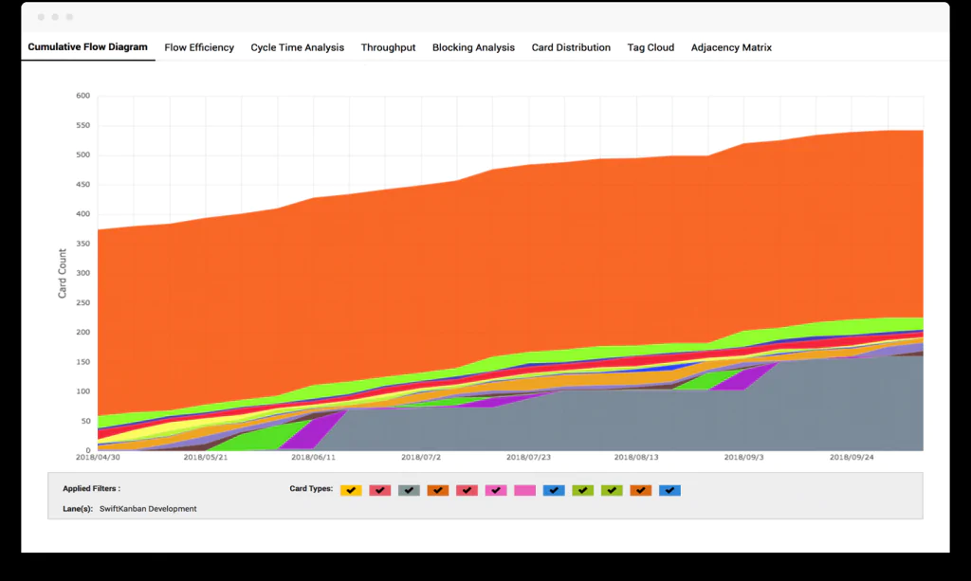
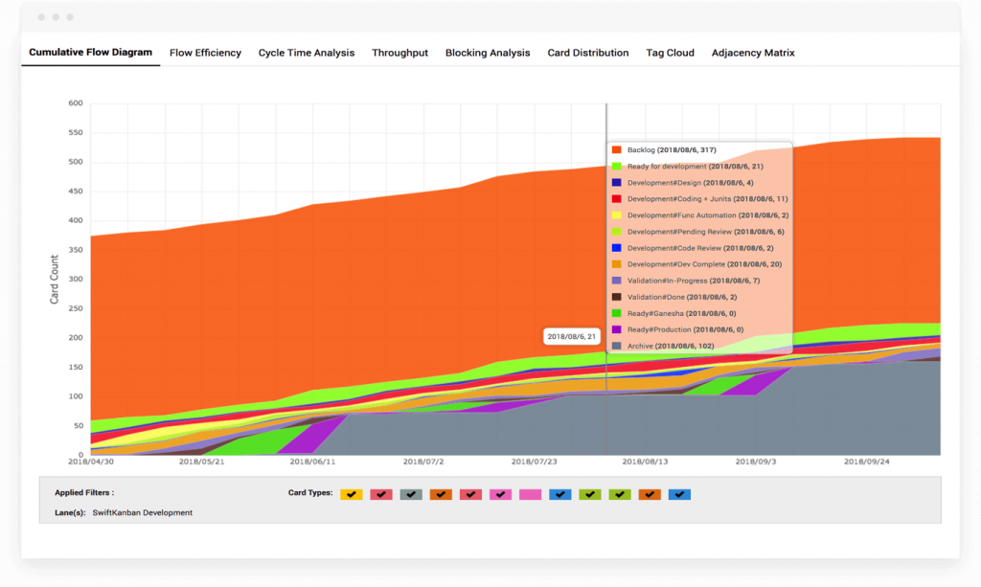
Kanban metrics

Slide 32
Kanban metrics
cont’d
Lead time: Time between a request being made and a task being released
Cycle time: Time between starting working on a task and releasing the task
Work-in-Progress (WIP): measured along the vertical axis. Reducing WIP and balancing WIP limits results in a smooth flow

Slide 33
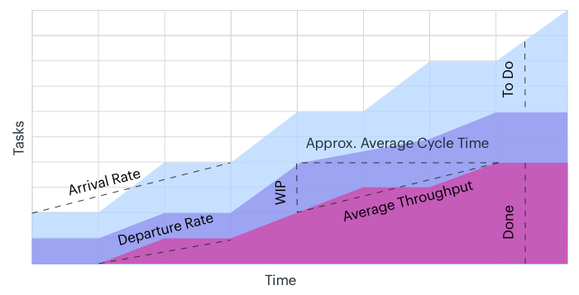
Kanban metrics
cont’d
Avg. Lead Time?

Slide 34
Kanban metrics
cont’d
Process Bottlenecks: Increasing thickness of an individual band indicates a bottleneck in that stage of the workflow.
Because of delays in that step
Or because of a hold up in the next step in the process
Kaizen discussion: within the team on how to resolve and to remove the bottleneck

Slide 35
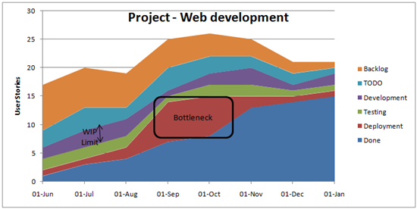
Kanban metrics
cont’d

Slide 36
Principles of Kanban
Start with what you are doing now
Agree to pursue incremental, evolutionary change
Respect current roles, responsibilities and job-titles
Encourage acts of leadership at all levels

Slide 37
Practices of Kanban
Visualize the flow of work
Limit WIP (Work in Progress)
Manage Flow
Make Process Policies Explicit
Implement Feedback Loops
Improve Collaboratively, Evolve Experimentally

Slide 38
Kanban VS Scrum

Slide 39
Kanban | Scrum
Continuous Delivery | Timeboxed Sprints
Less process and overhead | Has prescribed Sprint rituals and roles
Focuses on completing individual items quickly | Focuses on completing a batch of work quickly
Measures Cycle Time | Measures Sprint Velocity
Limits WIP for individual items | Limits WIP at a Sprint level

Slide 40
Kanban | Scrum
Individual work items are pulled | Work is pulled in batches
No prescribed roles | Has prescribed roles (Scrum Master, Product Owner, Team Member)
A single cross-functional team or multiple specialized teams | A single cross-functional team
Changes can be made at any time | Changes are only allowed in the Product Backlog
When incremental improvements are needed | Where fundamental changes are needed

Slide 41
Kanban; Pros and Cons

Slide 42
Kanban Advantages
Easy to Use, less training
Can Work in Many Different Industries
Encourages Collaboration
Eliminates Waste
Worker Satisfaction
Just in Time
Always Adapting

Slide 43
Kanban Disadvantages
Low Margin for Error
Can be Less Useful in a Dynamic Setting
Worker Frustration
Doesn’t Consider the Timeframes of tasks

Slide 44
When to use kanban ?
If your team is on good knowledge and doesn’t need lots of meetings and explanation then kanban is the right choice for you
if your task is continuous like tickets and customer support that can’t be handled easily with other agile methodologies like scrum because it depend on sprints of average 2 weeks while kanban is continuous operation

Slide 45
Kanban Demo

Slide 46
Tools:
1- kanbanize: kanbanize website
2-Jira : jira website
3-trello: Trello website

Slide 47
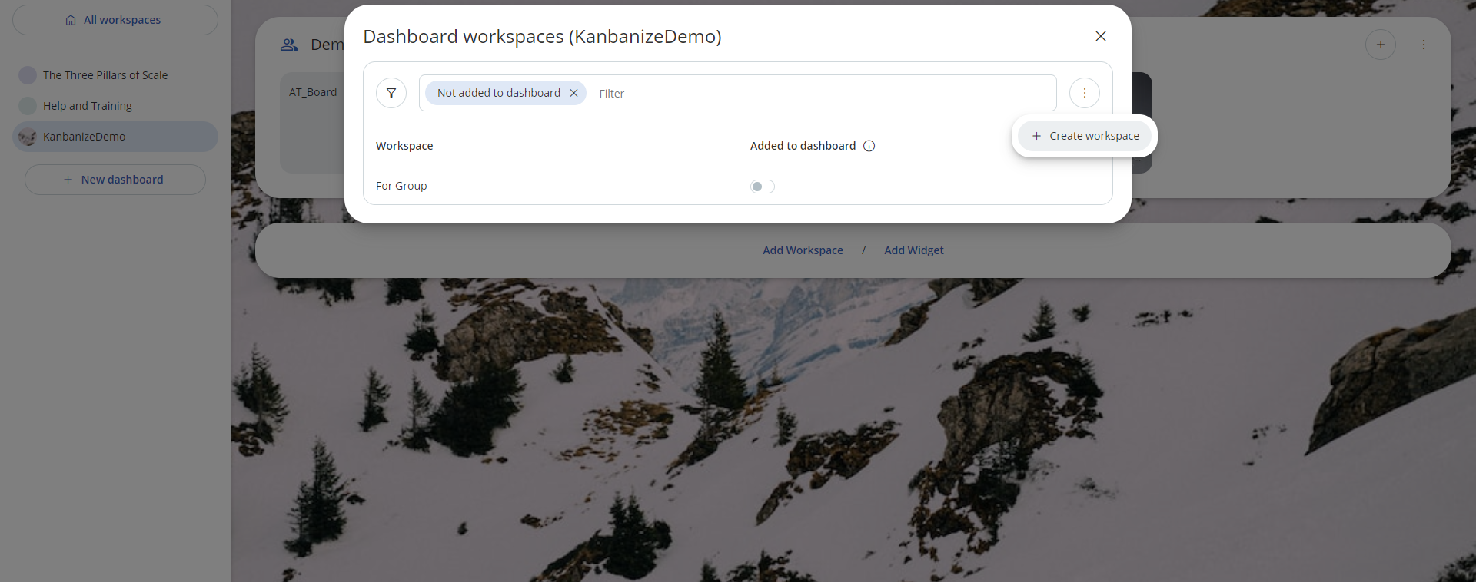
Demo using kanbanize :
1-Create new workspace and board

Slide 48
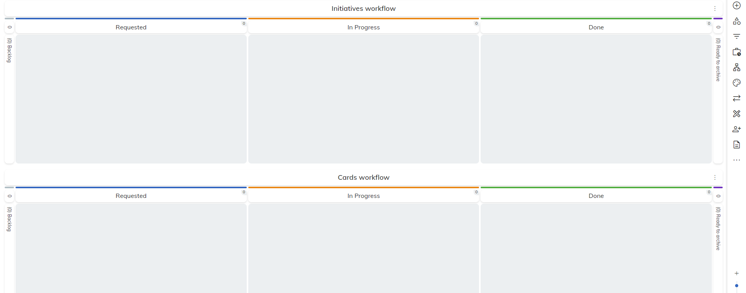
Demo using kanbanize
cont’d
2-Check normal board of kanbanize

Slide 49
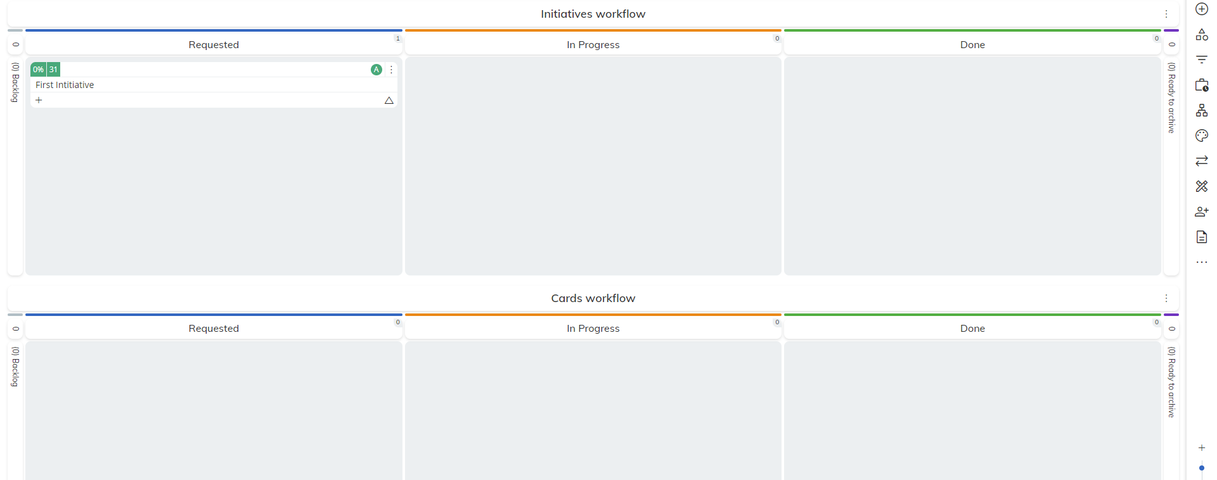
Demo using kanbanize
cont’d
3-Creating new initiative

Slide 50
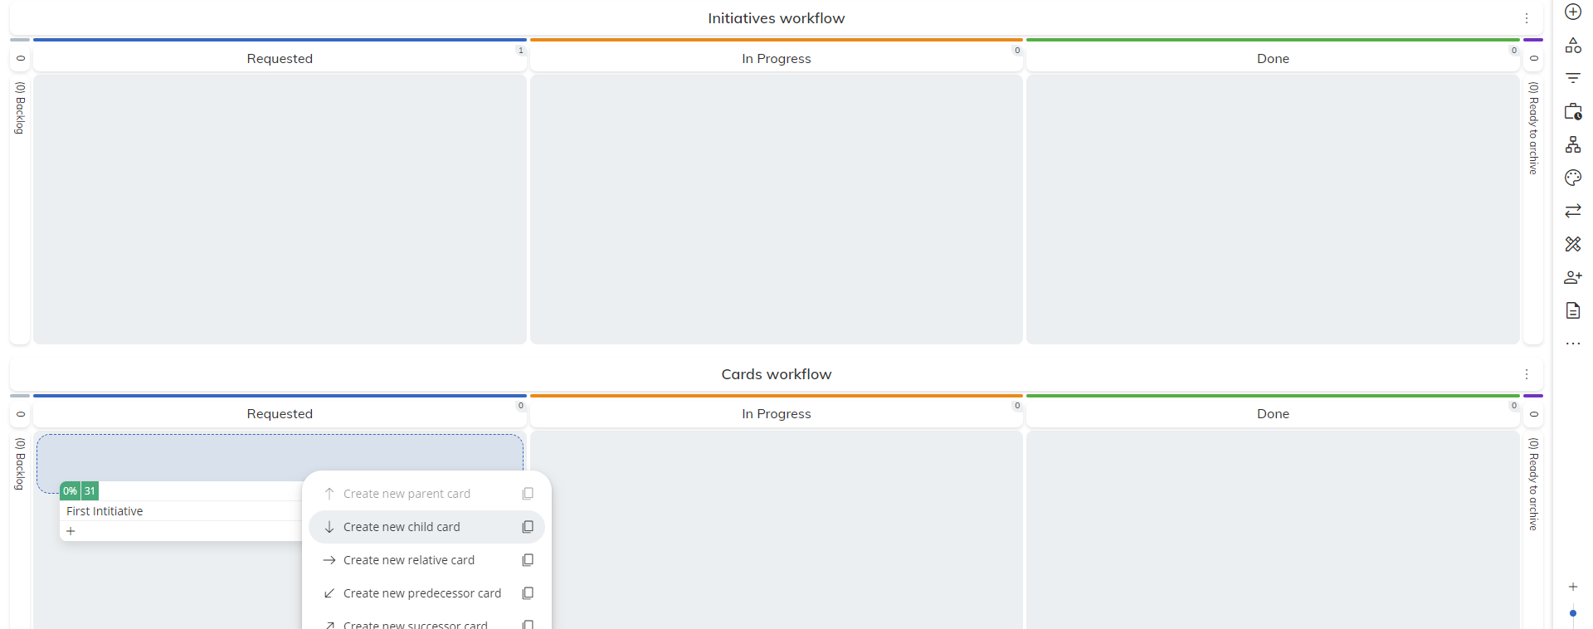
Demo using kanbanize
cont’d
4-Adding child card to the initiative

Slide 51
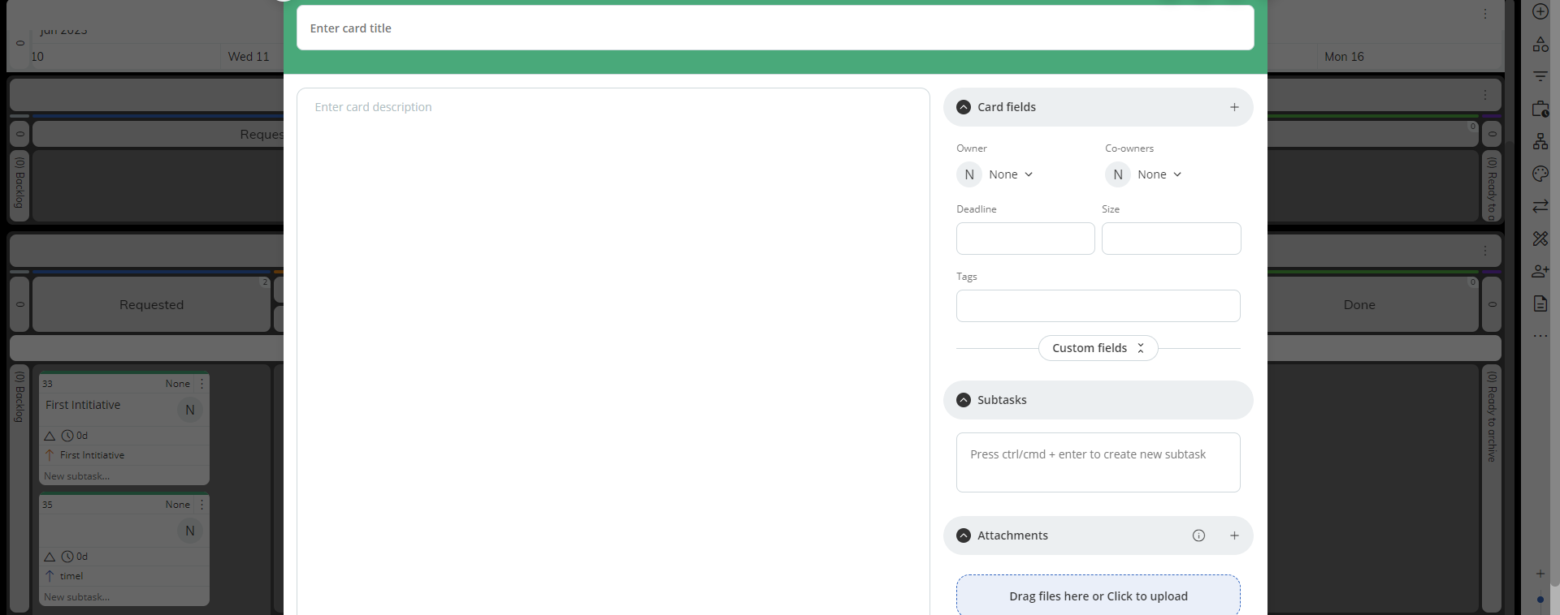
Demo using kanbanize
cont’d
5-Card details

Slide 52
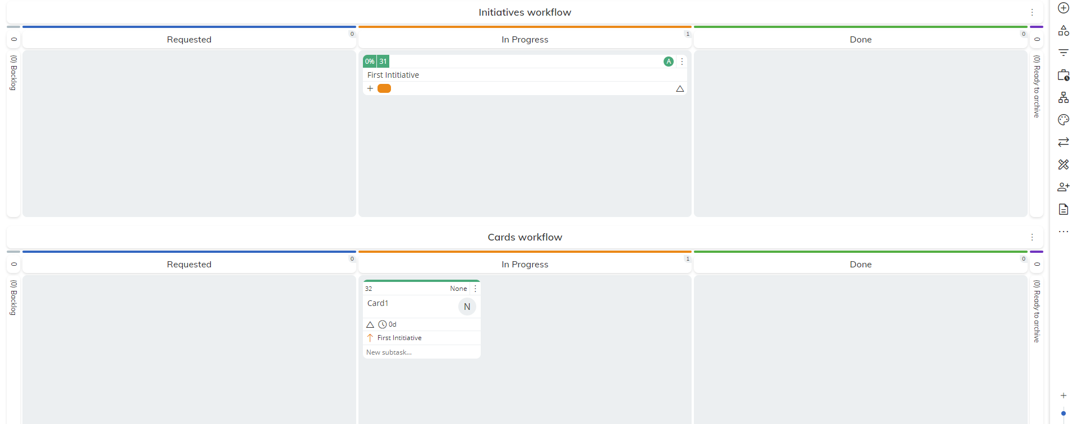
Demo using kanbanize
cont’d
6-Initiative card moving according to its childs state

Slide 53
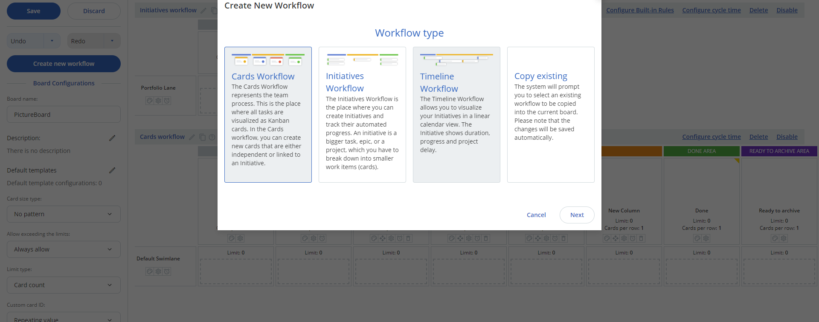
Demo using kanbanize
cont’d
7-Create new workflow and its options

Slide 54
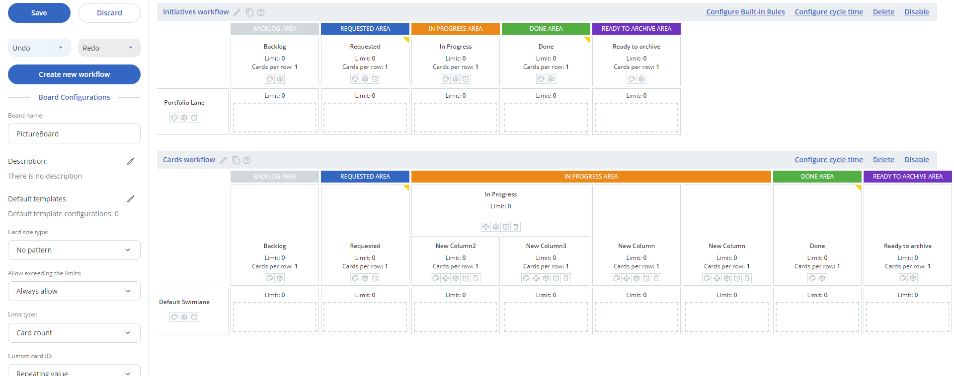
Demo using kanbanize
cont’d
8-Editing workflow (adding new workflows, columns ,subcolumns,cycle time and WIP limit)

Slide 55
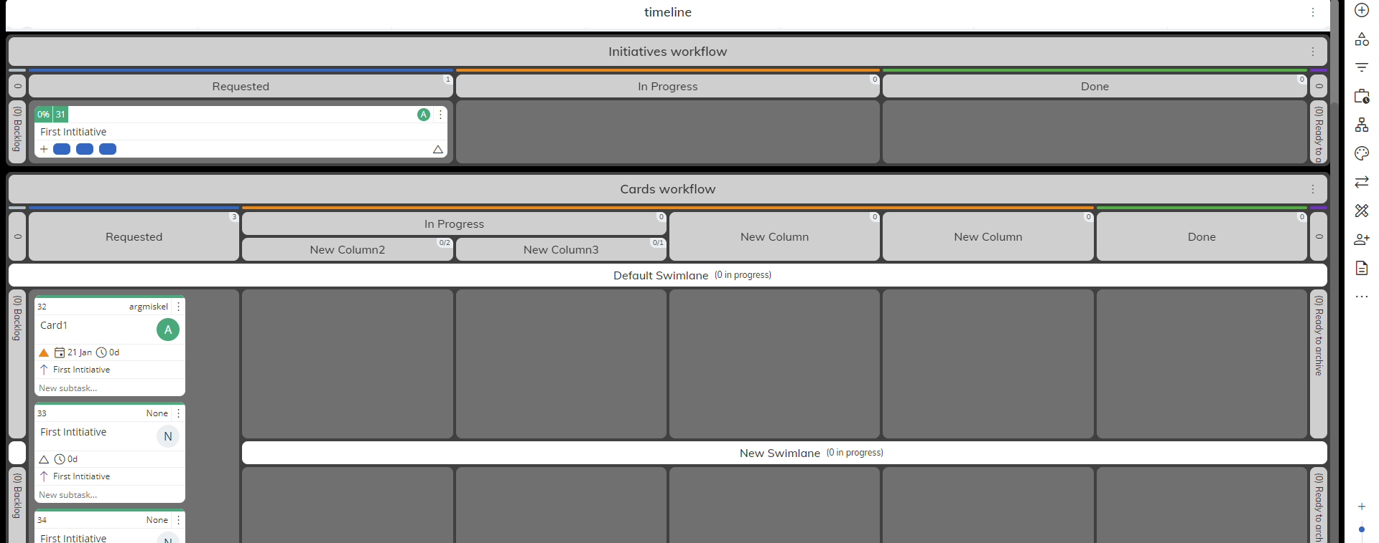
Demo using kanbanize
cont’d
9-Board after editing workflow

Slide 56
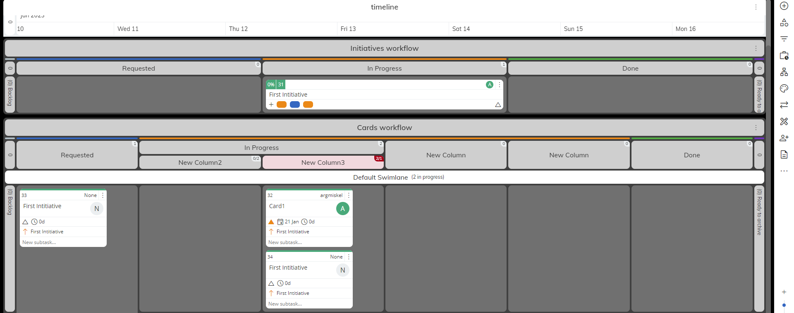
Demo using kanbanize
cont’d
10-After exceeding WIP Limit on one column

Slide 57
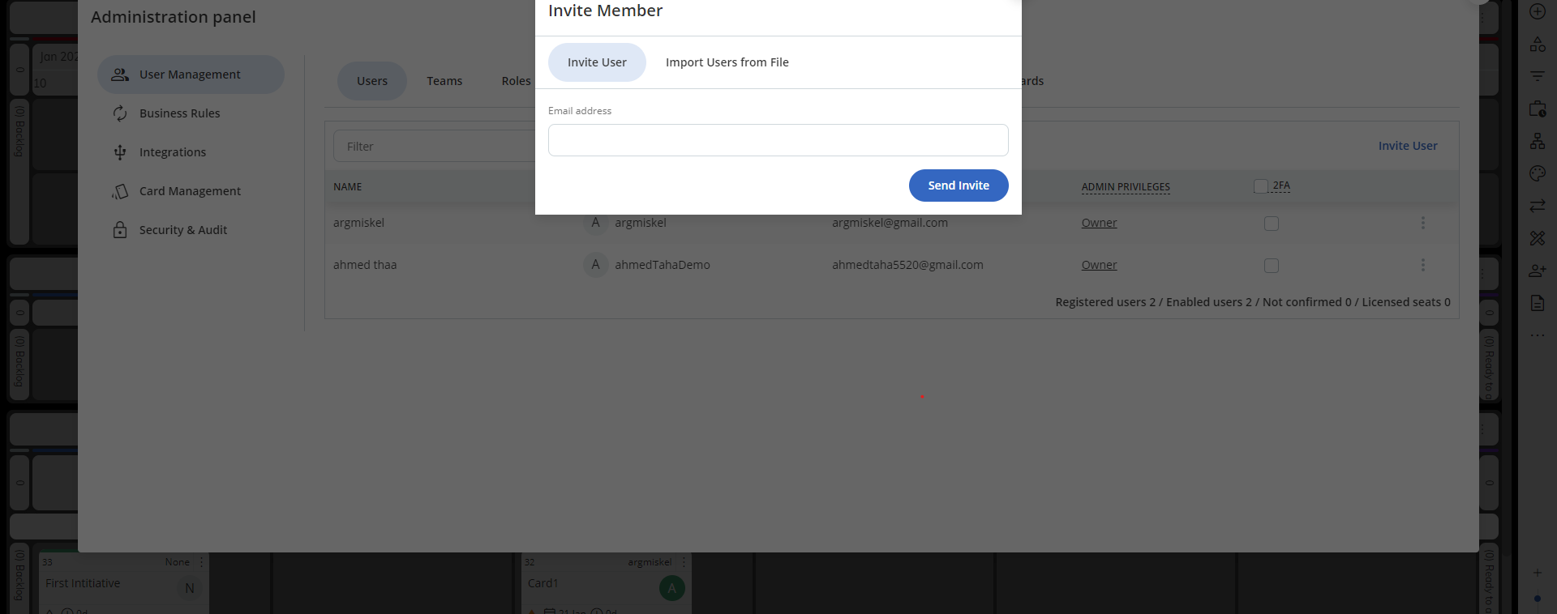
Demo using kanbanize
cont’d
11-Adding users to your board

Slide 58
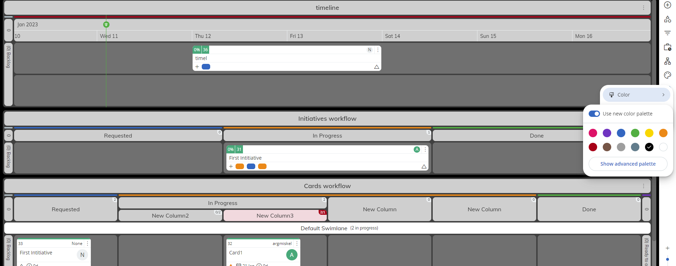
Demo using kanbanize
cont’d
12-Setting background color for the board

Slide 59
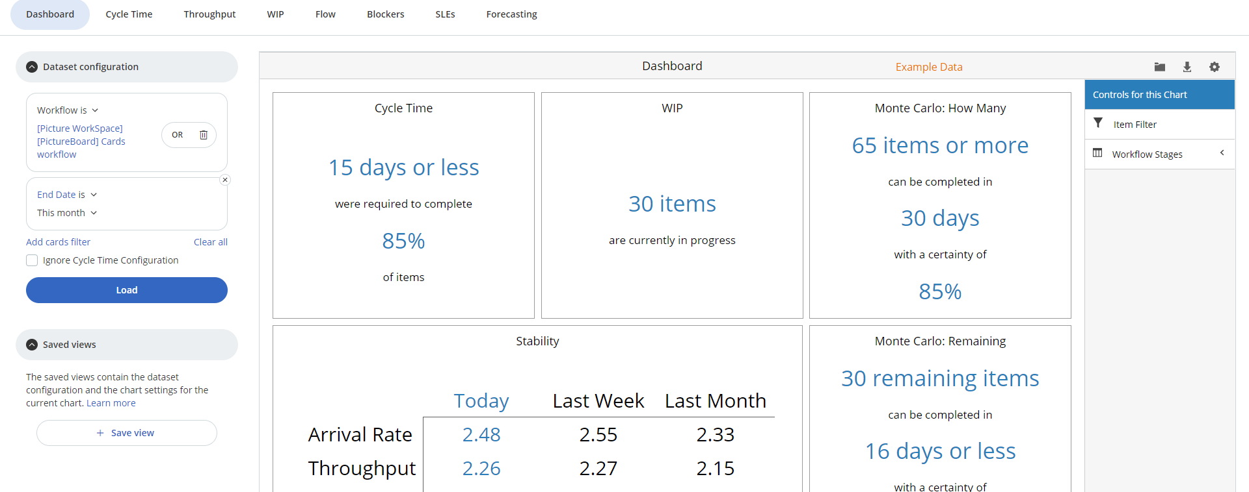
Demo using kanbanize
cont’d
13-Analytics of the dashboard using some example data

Slide 60
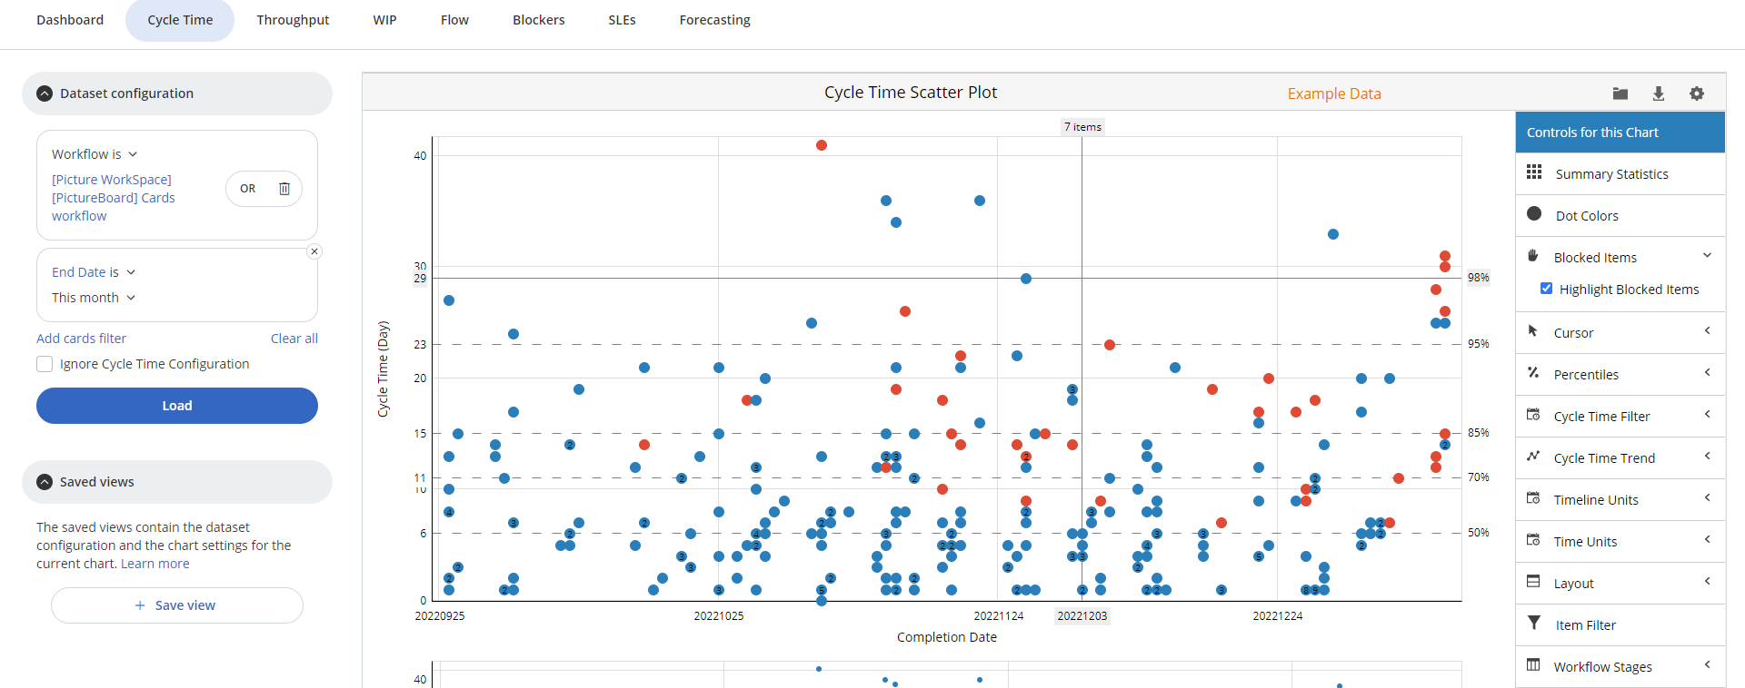
Demo using kanbanize
cont’d
14-Cycle time scatter plot

Slide 61
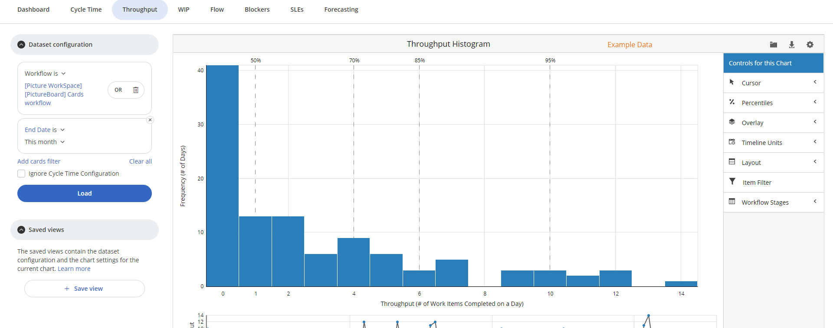
Demo using kanbanize
cont’d
15-Throughput histogram

Slide 62
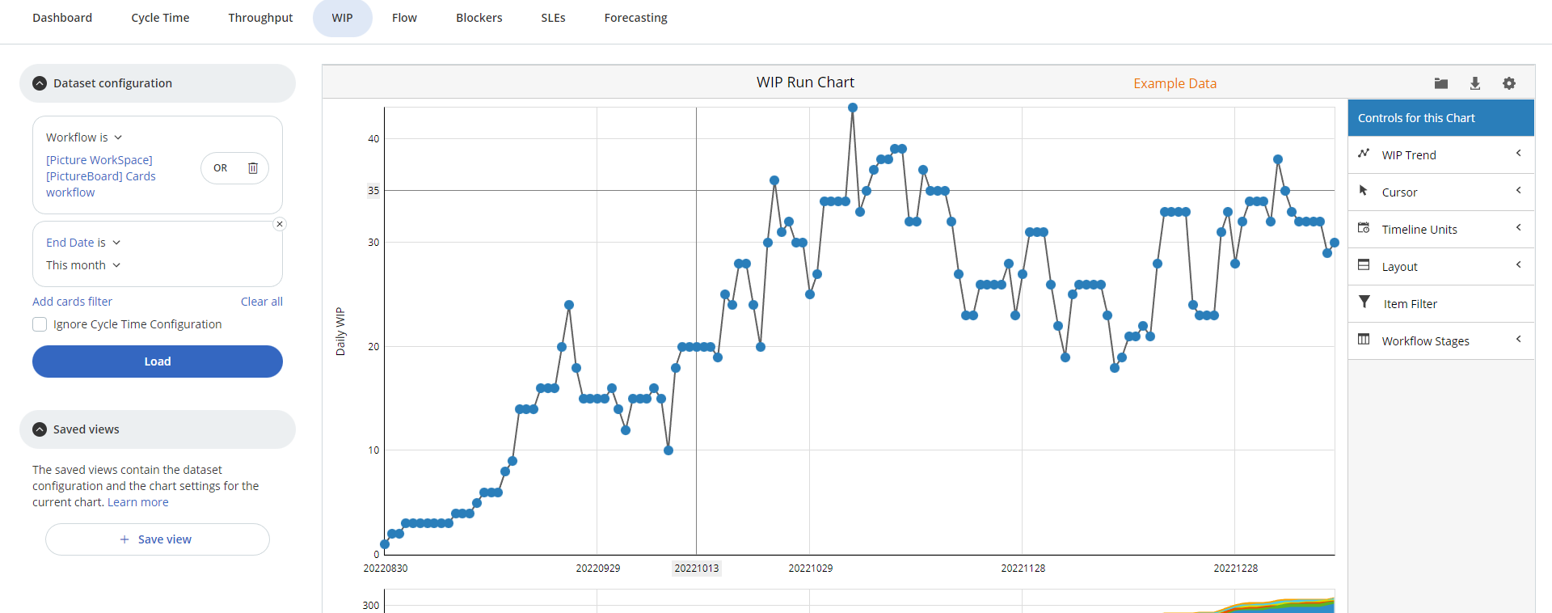
Demo using kanbanize
cont’d
16-WIP run chart

Slide 63
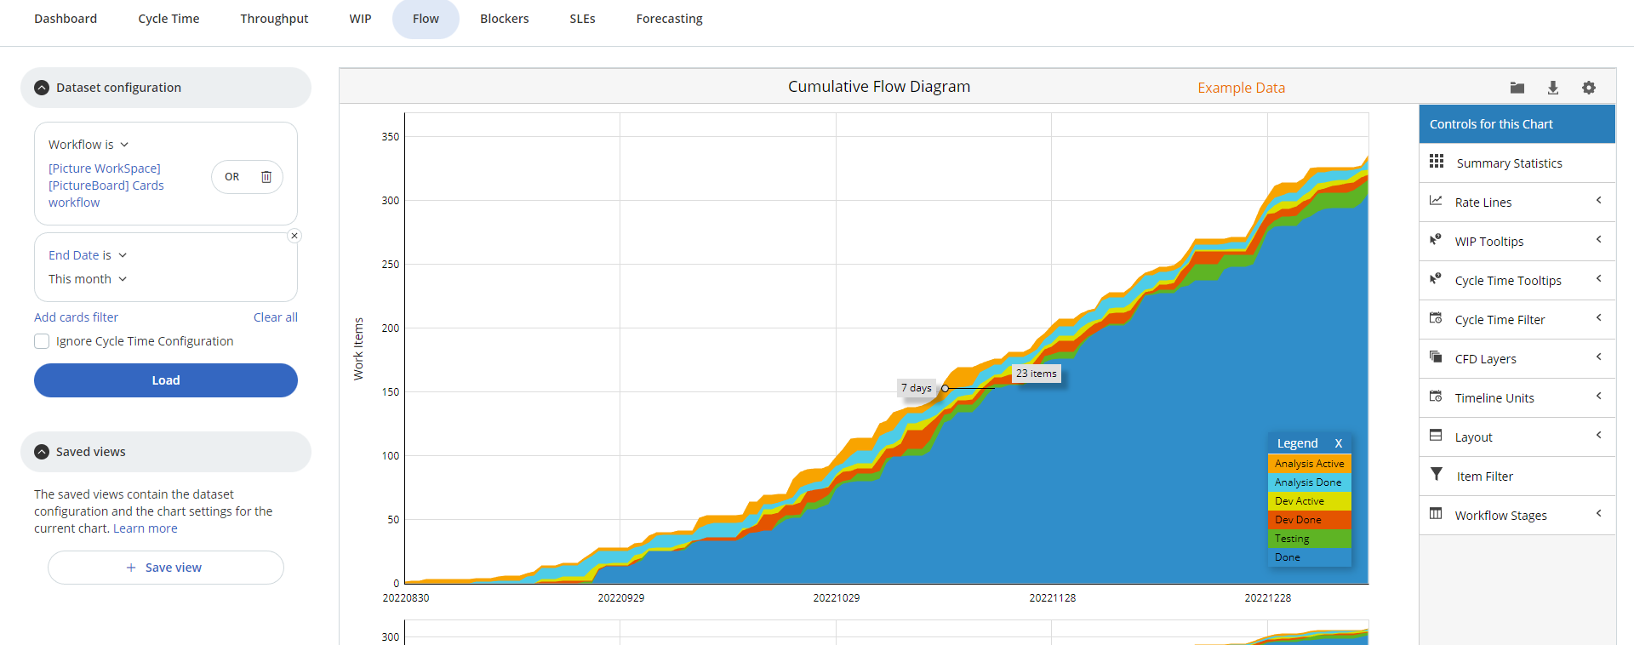
Demo using kanbanize
cont’d
17-Cumulative flow diagram

Slide 64
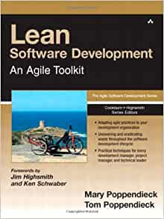
Lean References
Lean Software Development: An Agile Toolkit: Poppendieck, Mary, Poppendieck, Tom: 9780321150783: Amazon.com: Books

Slide 65
Kanban References
Bottlenecks: https://worldofagile.com/blog/cumulative-flow-diagram/
Kanbanize Tutorial: https://www.youtube.com/playlist?list=PLUkW5NwdUqCj-iTBOocE3XkUi3pXbENZa
CFD Metrics:
https://kissflow.com/project/agile/guide-to-cumulative-flow-diagram/
https://www.digite.com/kanban/kanban-metrics/
Principles & Practices: https://www.digite.com/kanban/what-is-kanban/#kanban-practices
Kanban vs Scrum: https://www.toptal.com/project-managers/agile/project-management-blueprint-part-1-agile-scrum-kanban-lean
Pros & Cons:
https://www.kanbanchi.com/kanban-style-work-boards
https://smallbusiness.chron.com/lean-manufacturing-pros-cons-44749.html

Slide 66


